Slide 1
Instructor Materials Chapter 10: Mobile, Linux, and OS X Operating Systems
IT Essentials v6.0
Notes:
Cisco Networking Academy Program
IT Essentials
Chapter 10: Mobile, Linux, and OS X Operating Systems

Slide 2
Instructor Materials - Chapter 10 Planning Guide
This PowerPoint is divided in two parts:
Instructor Planning Guide
Information to help you become familiar with the chapter
Teaching aids
Instructor Class Presentation
Optional slides that you can use in the classroom
Begins on slide #12
Note: Remove the Planning Guide from this presentation before sharing with anyone.
Notes:
2

Slide 3
ITE 6.0 Planning Guide
Chapter 10: Mobile, Linux, and OS X Operating Systems
Notes:
ITE 6.0 Planning Guide
Chapter 10: Mobile, Linux, and OS X Operating Systems

Slide 4
Chapter 10: Activities
What activities are associated with this chapter?
Page Number | Activity Type | Activity Name
10.1.2.3 | Lab | Working with Android
10.1.3.3 | Lab | Working with iOS
10.1.5.3 | Lab | Mobile Device Features
10.1.5.4 | Lab | Mobile Device Information
10.2.1.2 | Lab | Passcode Locks
10.3.1.2 | Lab | Mobile Wi-Fi
10.3.3.2 | Interactive Activity (IA) | Matching Email Protocols
Notes:
4

Slide 5
Chapter 10: Activities (Cont.)
What activities are associated with this chapter?
Page Number | Activity Type | Activity Name
10.4.1.4 | Lab | Install Linux in a Virtual Machine and Explore the GUI
10.4.1.7 | Video | Multiboot
10.4.3.3 | Lab | Working with the Linux Command Line
10.5.2.2 | Lab | Troubleshooting Mobile Devices
Notes:
5

Slide 6
Chapter 10: Assessment
Students should complete Chapter 10, “Assessment” after completing Chapter 10.
Quizzes, labs, Packet Tracers and other activities can be used to informally assess student progress.
Notes:
6

Slide 7
Chapter 10: Best Practices
Prior to teaching Chapter 10, the instructor should:
Complete Chapter 10, “Assessment.”
The goal of this chapter is to introduce mobile OSs, Linux and OS X.
Make sure students understand the differences between Open source and Closed source.
Explain Rooting, Jailbreaking and their benefits but make sure to focus on the downsides as well.
Stress the fact Android devices use apps to synchronize data not automatically synchronized by Google.
Stress how iOS devices rely on iTunes to synchronize data and other content.
Linux and OS X are UNIX derivatives and therefore, are very similar.
Notes:
7

Slide 8
Chapter 10: Best Practices (Cont.)
Prior to teaching Chapter 10, the instructor should:
Make sure students understand the CLI interface and its tools.
File permissions is one of the most important concepts in UNIX, Linux and OS X; make sure students understand it well.
Unity is relatively new and incorporated many UI elements already present on Aqua. It may helpful to students to bring this up.
Notes:
8

Slide 9
Chapter 10: Additional Help
For additional help with teaching strategies, including lesson plans, analogies for difficult concepts, and discussion topics, visit the ITE Community at community.netacad.net.
If you have lesson plans or resources that you would like to share, upload them to the ITE Community in order to help other instructors.
Notes:
9

Slide 10
Chapter 10: Topics in chapter that are not found in the CompTIA A+ 220-901 Certification
This slide lists content included in this chapter that is NOT listed in the CompTIA A+ 220-901 blueprint. Instructors could skip these sections; however, they should provide additional information and fundamental concepts to assist the student with the topic.
All content in Chapter 10 is aligned to the certification.
Notes:
10

Slide 11


Slide 12
Chapter 10: Mobile, Linux, and OS X Operating Systems
IT Essentials v6.0
Notes:
Cisco Networking Academy Program
IT Essentials
Chapter 10: Mobile, Linux, and OS X Operating Systems

Slide 13
Chapter 10 - Sections & Objectives
10.1 Mobile Operating Systems
Explain the purpose and characteristics of mobile operating systems.
10.2 Methods of Securing Mobile Devices
Explain methods for securing mobile devices.
10.3 Network Connectivity and Email
Explain how to configure network connectivity and email on mobile devices.
10.4 Linux and OS X Operating Systems
Explain the purpose and characteristics of Linux and OS X operating systems.
10.5 Basic Troubleshooting Process for mobile, Linux and OS X Operating Systems
Explain how to troubleshoot other operating systems.
10.6 Chapter Summary
Notes:
13

Slide 14
10.1 Android Vs. iOS
Notes:
Cisco Networking Academy Program
IT Essentials
Chapter 10: Mobile, Linux, and OS X Operating Systems

Slide 15
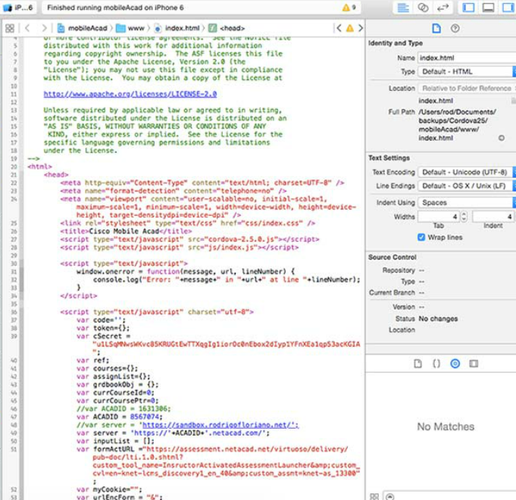
Mobile Operating Systems Android Vs. iOS
Open Source Vs. Closed Source
Open Source: the source code is provided with the compiled program.
Closed Source: the source code is not provided with the compiled program.
Android is open source while iOS is not.
Mobile Application Development
Mobile operating systems became software platforms.
Apps are designed and developed to run on mobile OSs.
Apple and Google provide development tools to app developers.
Application and Content Sources
Apps are essentially programs designed for mobile devices.
Mobile OS manufacturers usually maintain an online store where users can locate, download and install apps.
Android users can also sideload apps.
Users of stock iOS must use the official App Store to install apps.
Notes:
10.1 - Mobile Operating Systems
10.1.1 – Android Vs. iOS

Slide 16

Mobile Operating Systems Android Touch Interface
Home Screen Items
Android mobile devices organize icons and widgets on multiple screens.
Android’s home screen elements include: Navigation Icons, Google Search, Special Enhancements and Notification and System Icons.
The format of the home screen is defined by the launcher.
Managing Apps, Widgets and Folders
Apps are represented by icons and arranged in a grid.
In Android, home screen apps are simply a link; removing an app from the home screen does not uninstall it.
The user can customize the position of the apps.
Folders can also be created to group apps.
Widgets display information right on the home screen.
Notes:
10.1 - Mobile Operating Systems
10.1.1 – Android Touch Interface

Slide 17
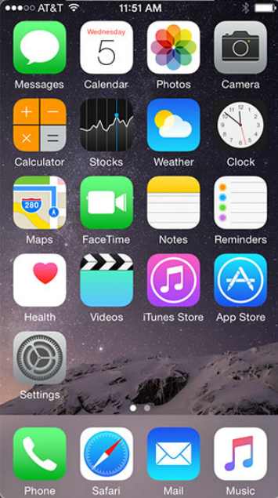
Mobile Operating Systems iOS Touch Interface
Home Screen Items
iOS mobile devices organize icons on multiple screens.
iOS home screen has no navigation icons and no widgets.
iOS relies on a few UI elements, including: Home Button, Notification Center and Spotlight (search tool).
The format of the home screen in stock iOS is defined by Apple and cannot be changed by the user.
Managing Apps and Folders
Apps are represented by icons and arranged in a grid.
In iOS, home screen apps are the actual app; removing an app from the home screen also uninstalls it.
The user can customize the position of the apps.
Folders can also be created to group apps.
There are no widgets on iOS.
Notes:
10.1 - Mobile Operating Systems
10.1.3 – iOS Touch Interface

Slide 18
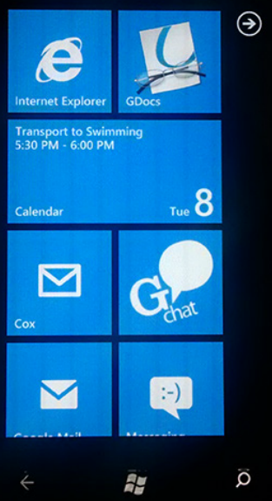
Mobile Operating Systems Windows Mobile Touch Interface
Home Screen Items
Also referred to as Start.
Based on Tiles
Tiles are apps and can display information or allow interaction right on the home screen
No icons
Navigation icons include: Back, Windows Button and Search
Managing Apps and Folders
Apps are represented by Tiles
Apps can be pinned to or unpinned from Start
Unpinning an app does not uninstall it
The user can customize the position of the apps
Tiles can also be resized
Folders can also be created to group apps
Notes:
10.1 - Mobile Operating Systems
10.1.4 – Windows Mobile Touch Interface

Slide 19
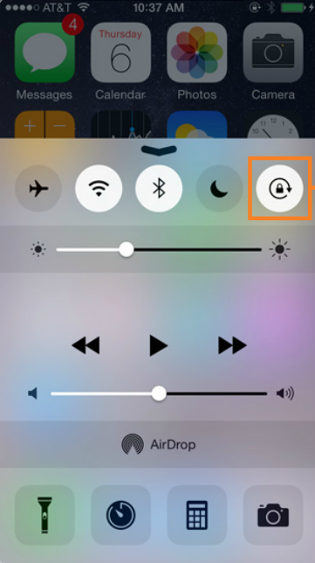
Mobile Operating Systems Common Mobile Device Features
Screen Orientation and Calibration
Mobile devices can operate in portrait or landscape.
Sensors such as the accelerometer, allow the OS to detect movement and automatically adjust screen orientation.
The user can also adjust brightness to match ambient conditions.
GPS
Modern mobile devices include a GPS receiver.
Uses include: navigation, geocaching, geotagging, tailored search results and device tracking.
Convenience Features
These features are designed to make life easier.
These features include: Wi-Fi Calling, Mobile Payments and VPNs.
Information Features
These features are designed to make access to information easier; they include: Virtual Assistant, Google Now and Emergency Notifications.
Notes:
10.1 - Mobile Operating Systems
10.1.5 – Common Mobile Device Features

Slide 20
10.2 Methods for Securing Mobile Devices
Notes:
Cisco Networking Academy Program
IT Essentials
Chapter 10: Mobile, Linux, and OS X Operating Systems

Slide 21
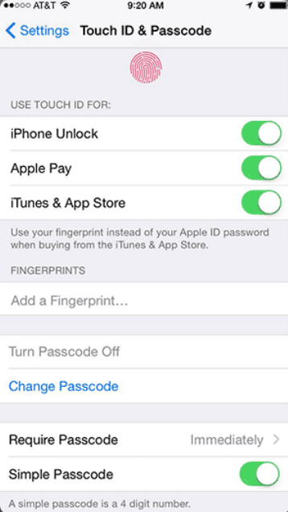
Methods for Securing Mobile Devices Passcode Locks
Overview of Passcode Locks
Helps protecting sensitive data.
The device cannot be accessed without the passcode.
Types of Passcodes include: None, Swipe, Pattern, PIN, Password, Trusted Devices, Trusted Places, Trusted Face, Trusted Voice, On-body Detection and Touch ID.
Restrictions on Failed Login Attempts
Prevents Passcode brute-force attacks.
Usually, the device is temporarily disabled after a certain number of failed unlocking attempts.
Different devices implement different restriction policies.
Notes:
10.2 – Methods for Securing Mobile Devices
10.2.1 – Passcode Locks

Slide 22
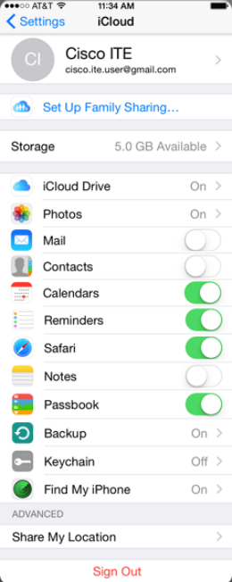
Methods for Securing Mobile Devices Cloud-Enabled Services for Mobile
Remote Backup
Mobile devices can automatically back up user data to the cloud.
Different cloud backup options are available.
Locator Applications
Extremely useful if the device is lost or stolen.
Locator apps allows the user to locate the device on a map.
Remote Lock and Remote Wipe
Other options include: remotely lock the device, send alerts to the device, or remotely erase it.
Notes:
10.2 – Methods for Securing Mobile Devices
10.2.2 – Cloud-Enabled Services for Mobile

Slide 23
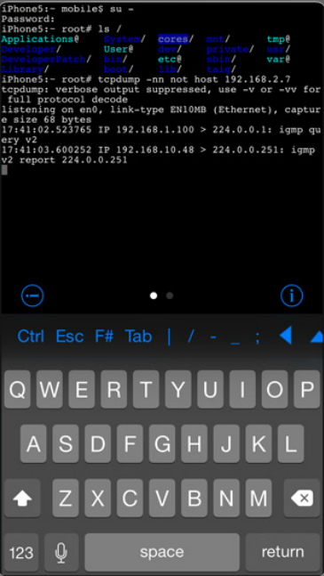
Methods for Securing Mobile Devices Software Security
Antivirus
Mobile devices are also vulnerable to malicious software.
The sandbox limits the damage in mobile devices.
User data can still be stolen and PCs can be infected.
Mobile antivirus apps are available for iOS and Android.
There are techniques to grant full access to a mobile device’s file system. The process is called Rooting on Android and Jailbreaking on iOS.
A Rooted/Jailbroken device will lose most (if not all) of the protection provided by sandboxing.
Patching and Updating Operating Systems
Updates add functionality or increase performance.
Patches can fix security problems or issues with hardware and software.
Both Android and iOS use an automated process for delivery.
Notes:
10.2 – Methods for Securing Mobile Devices
10.2.3 – Software Security

Slide 24
10.3 Network Connectivity and Email
Notes:
Cisco Networking Academy Program
IT Essentials
Chapter 10: Mobile, Linux, and OS X Operating Systems

Slide 25
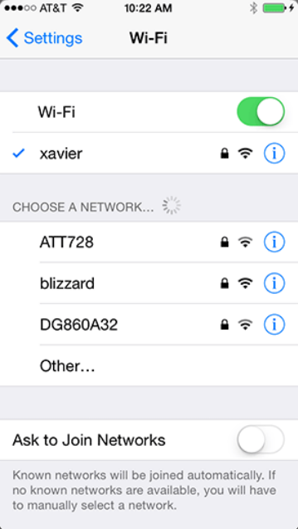
Network Connectivity and Email Wireless and Cellular Data Network
Wireless Data Network
Mobile devices can connect to the Internet via local Wi-Fi router.
Data transferred via local Wi-Fi router does not use the cellular carrier network and does not incur data charges to the user.
Coffee shops, libraries, schools, homes and work places are locations that usually provide free local Wi-Fi and Internet connections.
Cellular Communications
Usually broken down into generations.
There are currently four cellular technology generations: 1G, 2G, 3G and 4G (mobile WiMax and LTE).
Notes:
10.3 – Network Connectivity and Email
10.3.1 – Wireless and Cellular Data Network

Slide 26

Network Connectivity and Email Bluetooth
Bluetooth for Mobile Devices
Designed to connect devices in physical proximity to each other.
Bluetooth is wireless, automatic, and uses very little power.
Common Bluetooth devices include: headsets, keyboards, mice, car speakerphones and stereo controllers.
Bluetooth Pairing
Term used to describe two Bluetooth devices establishing a connection to share resources.
The Bluetooth radios must be on.
One device must be set to scan for possible peers; the other must be set to advertise its presence (discoverable mode).
For security, a PIN may be required before the pairing can be completed.
Notes:
10.3 – Network Connectivity and Email
10.3.2 – Bluetooth

Slide 27

Network Connectivity and Email Configuring Email
Introduction to Email
The email structure relies on servers and clients.
Email servers are responsible for forwarding email messages.
Users utilize email clients to compose, read and manage their messages.
While many different email clients exist for mobile devices, their configuration and operation is very similar.
Android Email Configuration
Many of the advanced web services are powered by Google.
While Android relies on a Gmail account for many services, other email providers are also supported by the OS.
iOS Email Configuration
iOS relies on an Apple ID for App Store access and other services.
iOS includes the Mail app which supports many different email accounts simultaneously.
Notes:
10.3 – Network Connectivity and Email
10.3.3 – Configuring Email

Slide 28
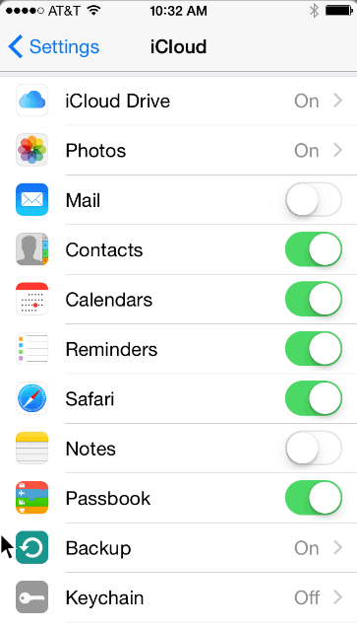
Network Connectivity and Email Mobile Device Synchronization
Internet Email
Usually provided through a web-based interface.
Some companies will also provide a mobile client app.
Mobile client apps usually present a better user experience than webmail on a mobile device.
Types of Data to Synchronize
Data synchronization updates user data in multiple devices.
The types of data that can be synchronized include: Contacts, Email, Calendar Entries, Pictures, Music, Apps, Video, Browser Links and Browser Settings.
Synchronization Connection Type
The most common connection types for syncing are USB and Wi-Fi.
Android syncs user data to web services such as Gmail and Google Calendar.
iOS uses iTunes to sync user data to a storage location which can be local or remote.
Notes:
10.3 – Network Connectivity and Email
10.3.4 – Mobile Device Synchronization

Slide 29
10.4 Linux and OS X Operating Systems
Notes:
Cisco Networking Academy Program
IT Essentials
Chapter 10: Mobile, Linux, and OS X Operating Systems

Slide 30
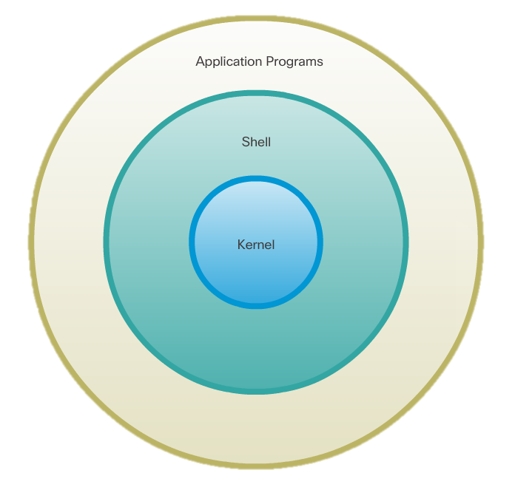
Linux and OS X Operating Systems Linux and OS X Tools and Features
Introduction to Linux and OS X Operating Systems
Linux and OS X are UNIX derivatives.
Both OSs kept most of the UNIX basic structure traits.
Overview of Linux and OS X GUI
Modern versions of Ubuntu Linux include Unity.
Modern versions of OS X include Aqua.
Unity and Aqua GUIs have similar UI elements.
Overview of Linux and OS X CLI
Due to their relation to UNIX, both Linux and OS X have similar CLI interfaces.
Text-based tools, the use of a shell, file system structure, file permissions and case-sensitivity are a few common characteristics inherited from UNIX and present in both OSs.
Notes:
10.4 – Linux and OS X Operating Systems
10.4.1 – Linux and OS X Tools and Features

Slide 31
Linux and OS X Operating Systems Linux and OS X Tools and Features (Cont.)
Overview of Backup and Recovery
Allows the user to restore or recover the data in case of failure.
Déjà Dup is an easy and efficient tool for backing up data in Linux.
OS X users can use Time Machine, a very user-friendly and efficient backup tool.
Déjà Dup and Time Machine are also very similiar.
Overview of Disk Utilities
Modern operating systems include disk tools to help troubleshoot and solve disk-related problems.
Most disk problems are the same regardless of the OS.
A good disk tool should be able to provide partition management, mount/unmount disk partitions, disk format, bad sector check and S.M.A.R.T. queries.
Disks and Disk Utility are disk tools included in Linux and OS X, respectively.
To install and boot more than one OS, a boot manager is required; GRUB and Boot Camp are popular boot managers for Linux and OS X, respectively.
Notes:
10.4 – Linux and OS X Operating Systems
10.4.1 – Linux and OS X Tools and Features (Cont.)

Slide 32
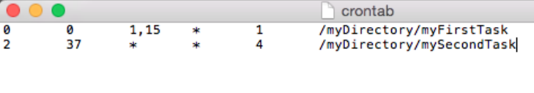
Linux and OS X Operating Systems Linux and OS X Best Practices
Scheduled Tasks
Maintenance tasks should be scheduled and performed frequently.
Computer systems can be programmed to perform tasks automatically.
Backups and Disk checks are two good examples.
The cron service can be use to schedule tasks in Linux and OS X.
Security
Measures can and should be taken to prevent malicious software from getting in a mobile computer system.
Common measures include: operating system updates, firmware updates, antivirus, and antimalware.
Notes:
10.4 – Linux and OS X Operating Systems
10.4.2 – Linux and OS X Best Practices

Slide 33
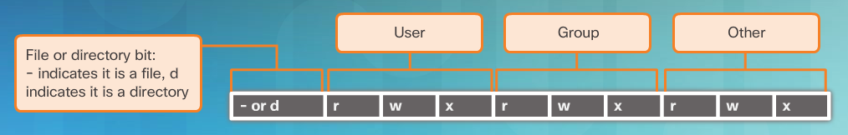
Linux and OS X Operating Systems CLI
File and Folder Commands
A number of command line tools are included in Unix-like systems by default.
Common file and folder related commands include: ls, cd, mkdir, cp, mv, rm, grep and cat.
Administrative Commands
UNIX and its derivatives utilize file permissions to create boundaries within the system.
Every file on Unix systems carries its file permissions.
UNIX file permissions can be Read, Write or Execute.
Notes:
10.4 – Linux and OS X Operating Systems
10.4.3 – CLI

Slide 34
10.5 Basic Troubleshooting Process for Mobile, Linux, and OS X Operating Systems
Notes:
Cisco Networking Academy Program
IT Essentials
Chapter 10: Mobile, Linux, and OS X Operating Systems

Slide 35
Basic Troubleshooting Process for Mobile, Linux and OS X OSs Applying the Troubleshooting Process to Mobile, Linux and OS X OSs
Identify the Problem
The first step in the troubleshooting process.
A good list of open-ended and closed-ended questions is helpful.
Establish a Theory of Probable Cause
This step is done after the problem is identified.
Refer to the documentation for a list of common probable causes.
Test the Theory to Determine the Cause
After a few probable causes are established, test the theories.
A list of quick test procedures can be helpful in this step.
Establish a Plan of Action to Resolve the Problem and Implement the Solution
Establish a plan of action to resolve the problem and implement the solution.
Refer to the documentation to gather additional information to resolve the issue.
Notes:
10.5 – Basic Troubleshooting Process for Mobile, Linux and OS X Oss
10.5.1 – Applying the Troubleshooting Process to Mobile, Linux and OS X Operating Systems

Slide 36
Basic Troubleshooting Process for Mobile, Linux and OS X OSs Applying the Troubleshooting Process to Mobile, Linux and OS X OSs
Verify Full System Functionality and Implement Preventive Measures
With the problem solved, verify full functionality.
A good list of the steps to verify the solution is useful in this step.
Document Findings, Actions and Outcomes
Document your finding for future reference.
Notes:
10.5 – Basic Troubleshooting Process for Mobile, Linux and OS X Oss
10.5.1 – Applying the Troubleshooting Process to Mobile, Linux and OS X Operating Systems (Cont.)

Slide 37
Basic Troubleshooting Process for Mobile, Linux and OS X OSs Applying the Troubleshooting Process to Mobile, Linux and OS X OSs
Identify Common Problems and Solutions
Computer problems can be attributed to hardware, software, networks, or some combination of the three.
Many problems can be solved with a reboot.
When a mobile device does not respond to a reboot, a reset may need to be performed.
When a standard reset does not correct the problem, a factory reset may need to be performed.
When a reboot does not fix a PC, more investigation should be done.
Some configuration could be changed, software updates could be required or a misbehaving program is the culprit and must be reinstalled.
Notes:
10.5 – Basic Troubleshooting Process for Mobile, Linux and OS X Oss
10.5.2 – Common Problems and Solutions for Mobile, Linux and OS X Operating Systems

Slide 38
10.6 Chapter Summary
Notes:
Cisco Networking Academy Program
IT Essentials
Chapter 10: Mobile, Linux, and OS X Operating Systems

Slide 39
Chapter Summary Summary
This chapter introduced you to mobile devices, the operating systems used on mobile devices, how to secure mobile devices, the uses of cloud-enabled services for mobile devices, and the way that mobile devices connect to networks, devices, and peripherals.
This chapter also covered Ubuntu Linux and Apple OS X operating systems and some of its main characteristics including: command line interface, command line-based tools, graphical user interfaces used and some GUI-based tools. This chapter also covered the primary maintenance tasks and related tools.
The basics of troubleshooting mobile operating systems, Linux and OS X were discussed with examples of simple solutions for common problems. The following concepts from this chapter are important to remember:
Open source software can be modified by anyone with little or no cost.
Use only trusted content sources to avoid malware and unreliable content.
Both Android and iOS have similar GUIs for using apps and other content.
Email accounts are closely tied to mobile devices and provide many different data synchronization services.
Notes:
2.3.1.1 - Summary

Slide 40
Chapter Summary Summary (Cont.)
The following concepts from this chapter are important to remember:
Android devices use apps to synchronize data not automatically synchronized by Google.
iOS devices use iTunes to synchronize data and other content.
Passcode locks can secure mobile devices.
Remote backups can be performed to backup mobile device data to the cloud.
Remote lock or remote wipe are features used to secure a mobile device that has been lost or stolen.
Antivirus software is often used on mobile devices to prevent the transfer of malicious programs to other devices or computers.
Notes:
2.3.1.1 – Summary (Cont.)

Slide 42


Slide 43
Chapter 10 New Terms and Commands
accelerometer
airdrop
airplane (phone mode)
alert (notification)
androidzoom
apk
ascii
badge (notifdication)
bloatware
cortana
cron
crontab
eterm
firewire
geocaching
geotagging
gpu
imap
imap4
ios
ip
iphone
iphone5
iso
isp
itunes
jailbreaking (iphone)
jslinux
konsole
lte
lts
mac
macintosh
mms
multiboot
netbooks
netstat
openssh
oss
overclocked
paypal
Notes:
New Terms and Commands

Slide 44
Chapter 10 New Terms and Commands (Cont.)
sdk
sideloading
siri
ubuntu
uname
unity (GUI)
unix
vpn
wap
wea
weas
xcode
xterm
yosemite (OS version)
Notes:
New Terms and Commands (Cont.)

